Slide 1
University of Hong Kong
Trading Workshop
Class 3
Treasury Workshop I
Foreign Exchange & Money Markets
David Lo

Slide 2
FX Spot Dealer/Trader/Corporate Sales
FX SPOT TRADERS TRADE CURRENCIES IN ORDER TO SERVICE ORDERS
FROM CORPORATE CUSTOMERS, INTERNAL CUSTOMERS (OTHER DESKS,
BRANCHES, SUBSIDIARIES) OR OTHER BANKS WITH WHOM THE TRADER
HAS A RELATIONSHIP (INTERBANK).
WHAT MOTIVATES FX SPOT DEALERS?
• Money – and big bonuses in particular
• Targets motivate too – making money for the bank which usually
equates to a personal bonus
• Thrill of putting a large deal through
• The excitement of the market
WHAT ISSUES DO THEY FACE?
What is their position?
Where are their limits?
Spot dealers constantly evaluate their position and calculate their profit and loss
by monitoring the mark-to-market value of their position
What is going on in the market? UP or Down? Bad News?

Slide 3
Money Market Dealer
Money market traders are primarily active in the short-term interest rate market; however in some cases they are responsible for the ‘book’ one year out.
They trade Deposit (Depos), commercial paper (CPs), treasury bills (T-Bills), FX forward, forward rate agreements (FRAs), overnight index swaps (OIS), repurchase agreements (Repos), short term interest rate (STIR) futures, certificates of deposit (CDs).
Money market dealers trade in forward market actively. They service customer orders: internally from departments such as Asset Management and externally from the interbank market or large corporate. Money market traders also run positions, speculating in the hope of profiting from market movement

Slide 4
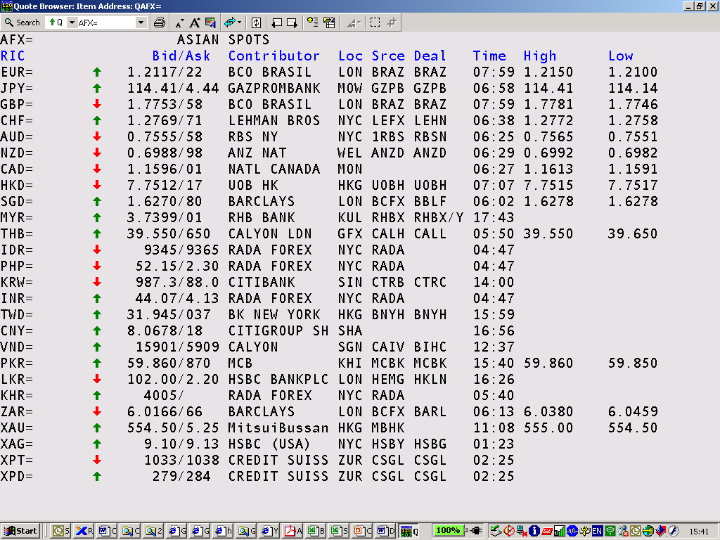
FX Spot Rates (AFX= EFX= NFX= EUR= HKD=)

Slide 5
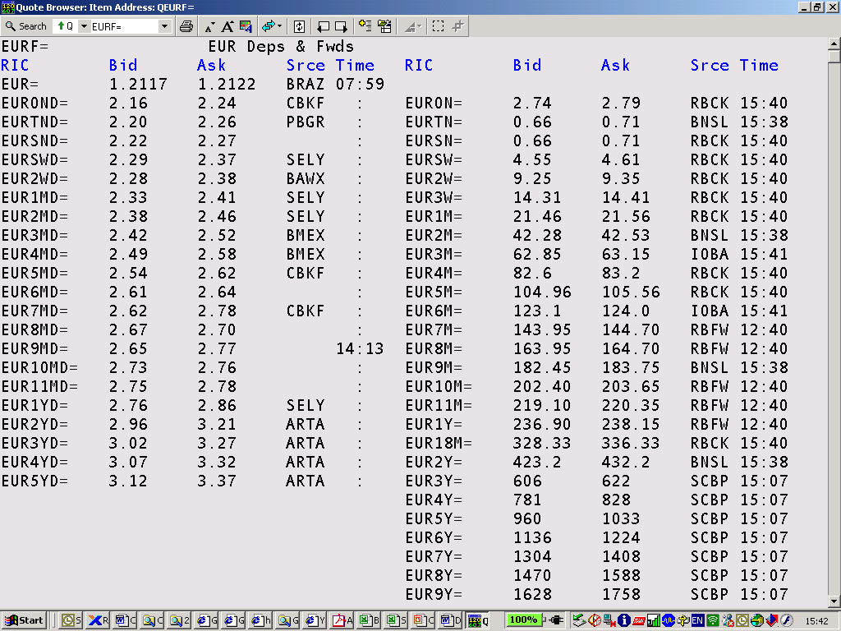
FX Forward Rates (0#FORWARD EURF= HKDF= )

Slide 6
FX Spot
A FX spot transaction is an agreement to exchange two different currencies at an agreed exchange rate for settlement in two business days time
Transaction
Delivery or value
Today
2 days from today

Slide 7
FX Outright
FX outright is an agreement to exchange two currencies at a rate agreed today, for delivery on an agreed future date
Transaction
Delivery or value
Today
Future date

Slide 8
FX Outright
FX outright consists of a spot deal and a forwards deal
Buy 3 month USD outright against JPY
3 month USD/JPY forwards
sell USD/JPY
buy USD/JPY
buy USD/JPY
Today
Spot date
Future date

Slide 9
FX Outright
If forwards are quoted as premium
  outright = spot + forwards pips
If forwards are quoted as discount
  outright = spot - forwards pips

Slide 10
FX Outright
Example -
You are a dealer. If USD/SGD is 1.6720/23, and 3 month USD/SGD
is 48/52, what is the 3 month outright rate that you would quote to
your client if the client wants to buy USD forward?
Solution -
objective – construct 3 month USD/SGD O/R to sell to client
buy USD from market over spot,
spot SGD offer = 1.6723
sell/buy USD with market to swap spot value to 3 month,
3 month SGD offer = +52
therefore, now you have USD to sell, & will quote an outright rate where
you sell USD/SGD 3 month FX outright at 1.6723 + 0.0052 = 1.6775

Slide 11
FX Outright
Example -
You are a dealer. If USD/JPY is 109.25/27, and 3 month USD/JPY
is 32/30, what is the 3 month outright rate that you would quote to
your client if the client wants to sell USD forward?
Solution -
objective - construct 3 month USD/JPY O/R to buy from client
sell USD to market over spot,
spot JPY bid = 109.25
buy/sell USD with market to swap spot value to 3 month,
quote 3 month JPY bid = -32
therefore, now you can buy USD, & will quote an outright rate where
you buy USD/JPY 3 month FX outright at 109.25 - 0.32 = 108.93

Slide 12
FX Forwards
How to calculate FX forwards?
  differential between two interest rates
USD Principal
USD Principal + Interest
USD/JPY
spot FX
USD/JPY
forwards
USD/JPY
outright
JPY Principal
JPY Principal + Interest

Slide 13
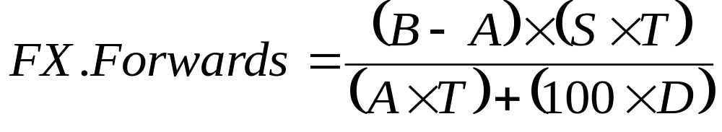
FX Forwards
FX Forwards = FX Outright – Spot FX
Where S = spot FX T = no. of days
A = base currency interest D = day count basis
B = counter currency interest

Slide 14
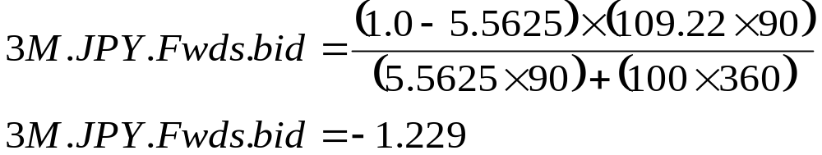
FX Forwards
Example -
If spot USD/JPY is 109.20/22, and 3 month USD is 5.5/5.5625% while
3 month JPY is 1.0/1.0625%, calculate the 3 month USD/JPY forwards.
Solution -
First, calculate the S/B(or bid) side,
A = USD MM offer = 5.5625 B = JPY MM bid = 1.0
S = spot JPY offer = 109.22 3 Months = 90 days

Slide 15
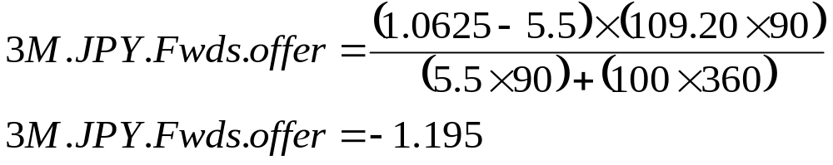
FX Forwards
Example -
If spot USD/JPY is 109.20/22, and 3 month USD is 5.5/5.5625% while
3 month JPY is 1.0/1.0625%, calculate the 3 month USD/JPY forwards.
Solution -
Second, calculate the B/S(or offer) side,
A = USD MM bid = 5.5 B = JPY MM offer = 1.0625
S = spot JPY bid = 109.20 3 Months = 90 days
∴ 3 month USD/JPY forwards = -1.229/-1.195
= 122.9/119.5 pips

Slide 16
Synthetic Deposits
How to create a synthetic deposit?
  using one deposit and FX forwards
Spot date
Maturity date
Position +USD
Borrow USD through MM
Position -USD
Position -USD
Position +USD
Sell/buy USD/JPY through forwards
Position +JPY
Position -JPY
Net +JPY
Synthetic JPY loan
Net -JPY

Slide 17
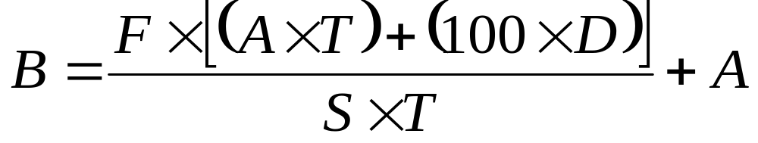
Synthetic Deposits
Implied counter currency deposits
Where S = spot FX
A = base currency interest
B = implied counter currency interest
F = forwards
T = no. of days
D = day count basis

Slide 18
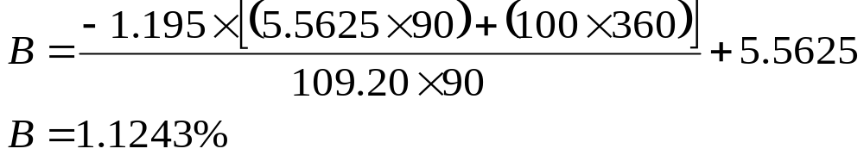
Synthetic Deposits
Example -
If spot USD/JPY is 109.20/22, and 3 month USD is 5.5/5.5625% while
3 month USD/JPY is 122.9/119.5, at what rate would you be borrowing
JPY through the FX forwards market? (You are market taker)
Solution -
First, borrow USD MM = A = 5.5625
then S/B USD/JPY in the forwards = F = -119.5 pips
S = spot JPY bid = 109.20 3 Months = 90 days

Slide 19
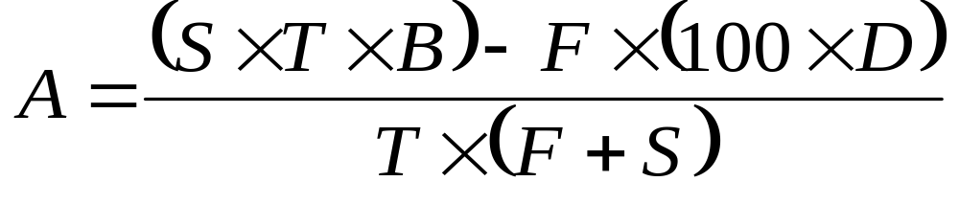
Synthetic Deposits
Implied base currency deposits
Where S = spot FX
A = implied base currency interest
B = counter currency interest
F = forwards
T = no. of days
D = day count basis

Slide 20
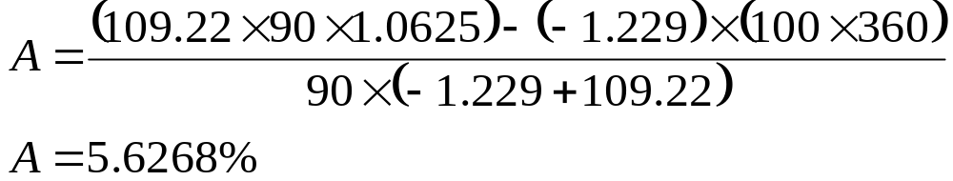
Synthetic Deposits
Example -
If spot USD/JPY is 109.20/22, and 3 month JPY is 1.0/1.0625% while
3 month USD/JPY is 122.9/119.5, at what rate would you be borrowing
USD through the FX forwards market? (You are market taker)
Solution -
First, borrow JPY MM = A = 1.0625
then B/S USD/JPY in the forwards = F = -122.9 pips
S = spot JPY offer = 109.22 3 Months = 90 days

Slide 21
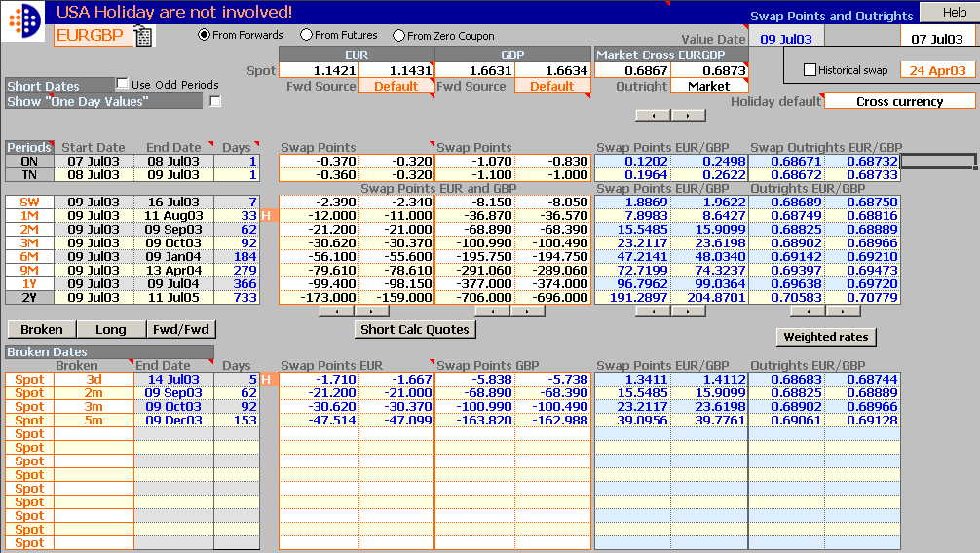
Swap Points & Outrights

Slide 22
Features and Benefits
Introduction
The Swap Points & Outrights worksheet enables you to calculate and display cross swap points and outrights in real-time for any currency or cross currency. Interpolation of real-time data is performed for non-standard periods and broken dates. The worksheet manages pre-spot broken date calculations and can use contributed rates for odd periods as well allowing you to disable any contributed standard period rates. Spot rates are also sourced from Reuters Dealing 2000-2, if available.
Features
Automatic Real-time interpolation for non-standard periods and broken dates
Perform pre-spot calculations
Contributed rates for odd periods
Disable any contributed standard period rates
Zero Coupon Curve feature
Industry standard calculations and algorithms
Benefits
Rapid calculation of Standard and Non-Standard periods
Rapid calculation of Broken dated periods
Build your own curve using Zero Coupon Curve feature
Price forwards from Forwards, Futures and Zero Curve

Slide 23
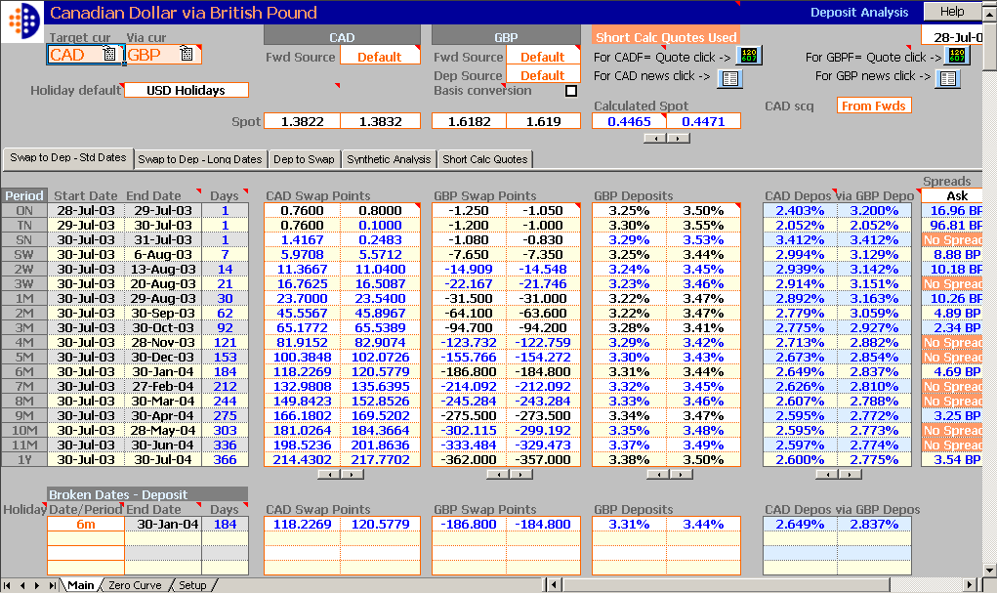
Deposit Analysis

Slide 24
Features and Benefits
For more information on new features in this version, click What's new on the menu.
Introduction
Using the Deposit Analysis worksheet you can calculate synthetic swap points and deposits using real-time data. You may view information for forwards points, and deposit rates for currency deals over specified or broken date periods. Access to current currency deposit rates is available. A number of brokerage rates may be selected.
Features
Calculate synthetic cross swap points using two real-time deposits and spot
Calculate synthetic deposits using cross swap points (Target cur and Via cur) and the Via cur Deposit rates. Interest Rate Swaps are also used for the calculation of the swap points
Benefits
Calculate synthetic deposits using one real-time deposit rate and two swap points from Target cur and the Via cur
Calculate up to four non-standard periods and long periods using the broken dates and LongDates functionality
Link to related news and quotes

Slide 25
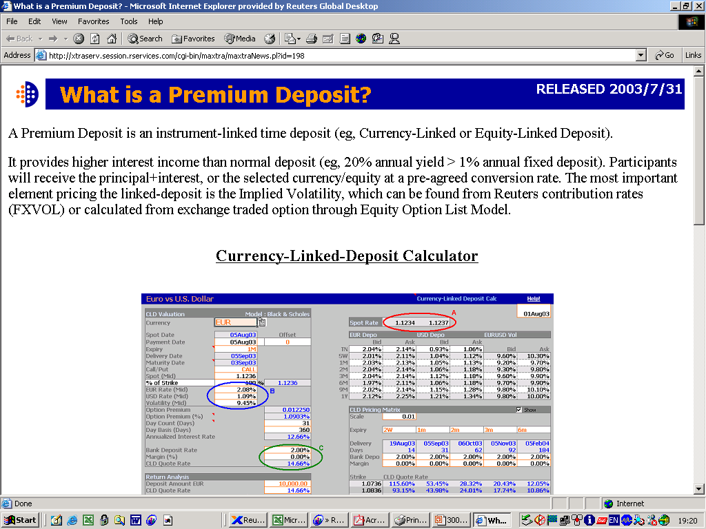

Slide 26
Q & A
DAVID_HKU@YAHOO.COM

